Slide 1

Meeting agenda tips
You can use this meeting presentation when following up on the results of the survey with your team and drafting an action plan. This sample presentation is based on two meetings with the team, but obviously it is possible to have a longer meeting or several shorter ones.
Go through the presentation and adapt it to your requirements. Look out for the tips and explanations in the notes below each slide.

Slide 2
MEETING 1

Slide 3
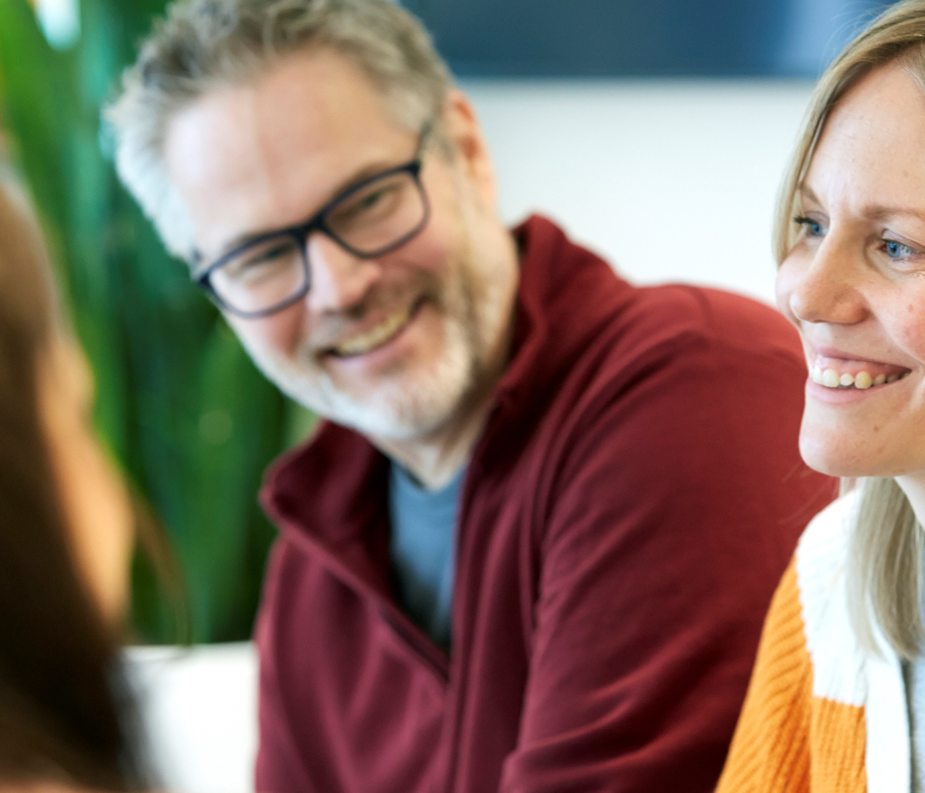
The OSWE survey
Meeting 1. What should improve?
Department/company
Date
Notes:
Tips prior to the first meeting:
The objective is for managers and employees to work together to prioritise among the questions/areas you want to continue working on. However, as the person running the survey, it’s important that you identify in advance questions whose results involve a major work environment risk, and ensure that measures addressing these questions are included in the action plan.
When you present the results to your employees, you can do so in different ways. You can base it on the link to the results/the results pages and scroll through. One option is to download the results as a PDF and show them the PDF file. The PDF does not show free text responses or spread, just the median. On the results page, clicking on a result (a yellow circle) shows the spread. The free text responses can be found at the bottom of the overview. We recommend that you show the results with the median value and not the spread. This is to avoid getting bogged down in details or prevent anyone from wondering who might have given a diverging answer.
Think about the division into groups. How many people in each group? How many groups in total? The more groups, the more suggestions you’ll come up with and need to prioritise among.
We’ve suggested a number of questions and measures in the presentation, but again, make adjustments according to what suits everyone best.
Print out the downloaded results (PDF) – one copy for each person present. This is required for small group discussions, when the groups usually leave the meeting room so they can discuss things separately.
If possible, book smaller rooms for the group discussions, or ensure there’s another suitable space for small group discussions adjacent to the meeting room.
It’s a good idea to have a whiteboard or flipchart in the meeting room.
Download the action plan template and keep it handy during the meeting. At the end of meeting 1, fill in the questions you want to continue working on.

Slide 4
The purpose of the employee survey is to improve the organisational and social work environment.
www.prevent.se/enkater
Notes:
Explain what the organisational and social work environment is and why it’s important.
https://www.prevent.se/jobba-med-arbetsmiljo/osa/

Slide 5
How we will proceed
By responding to the survey, we have investigated the work environment.
We will review and assess the risks of the results, working together to come up with appropriate measures that we will enter in an action plan.
We will implement the measures.
We will follow up and check that the measures have had the desired effect.
www.prevent.se/enkater
Notes:
This slide can be deleted, but it’s useful for the person running the survey. Read more about WEM here: https://www.prevent.se/jobba-med-arbetsmiljo/kom-igang/systematiskt-arbetsmiljoarbete/

Slide 6
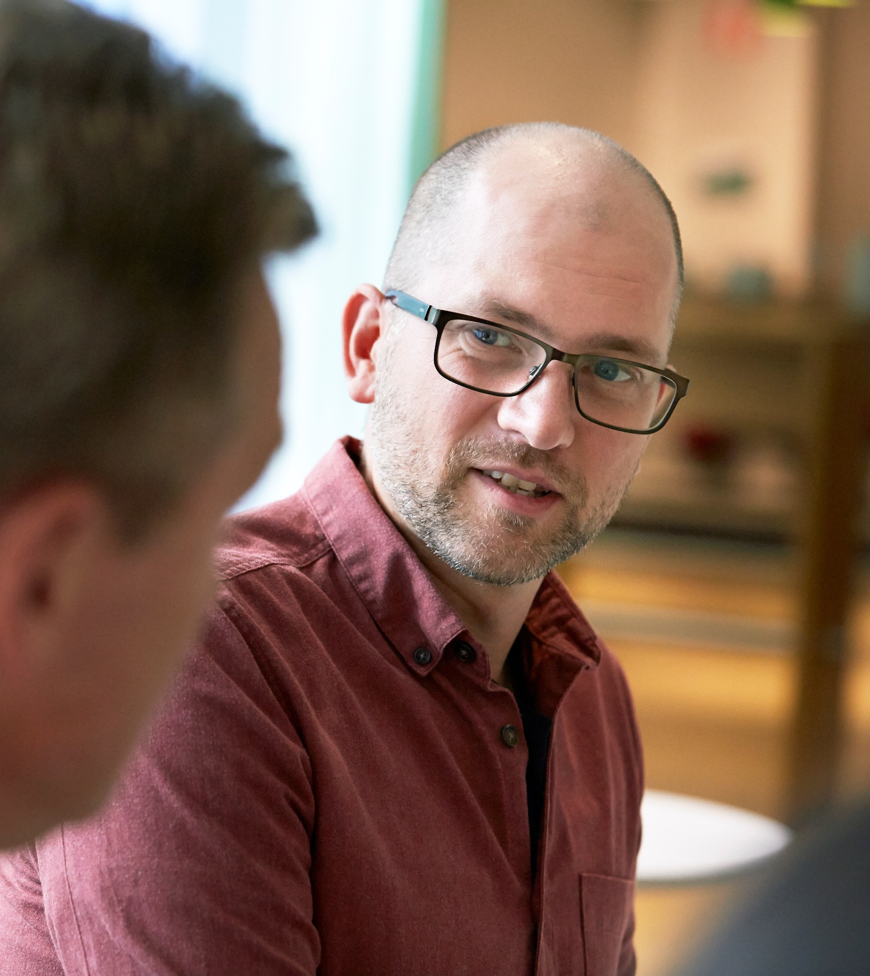
Agenda
Today
Go through the results together.
In small groups, come up with suggestions for what we should continue working on.
Present suggestions.
Prioritise what to continue working on.
Next meeting
Come up with suggestions for measures.
www.prevent.se/enkater

Slide 7
Action plan
www.prevent.se/enkater
Notes:
Action plan template. The aim of showing the slide is to give everyone an idea of what you need to achieve together in future meetings.
If you have your own risk assessment and action plan template, use it.
The action plan template can be downloaded here:
https://www.prevent.se/jobba-med-arbetsmiljo/enkater/osa-enkaten/resultat-och-atgarder/

Slide 8
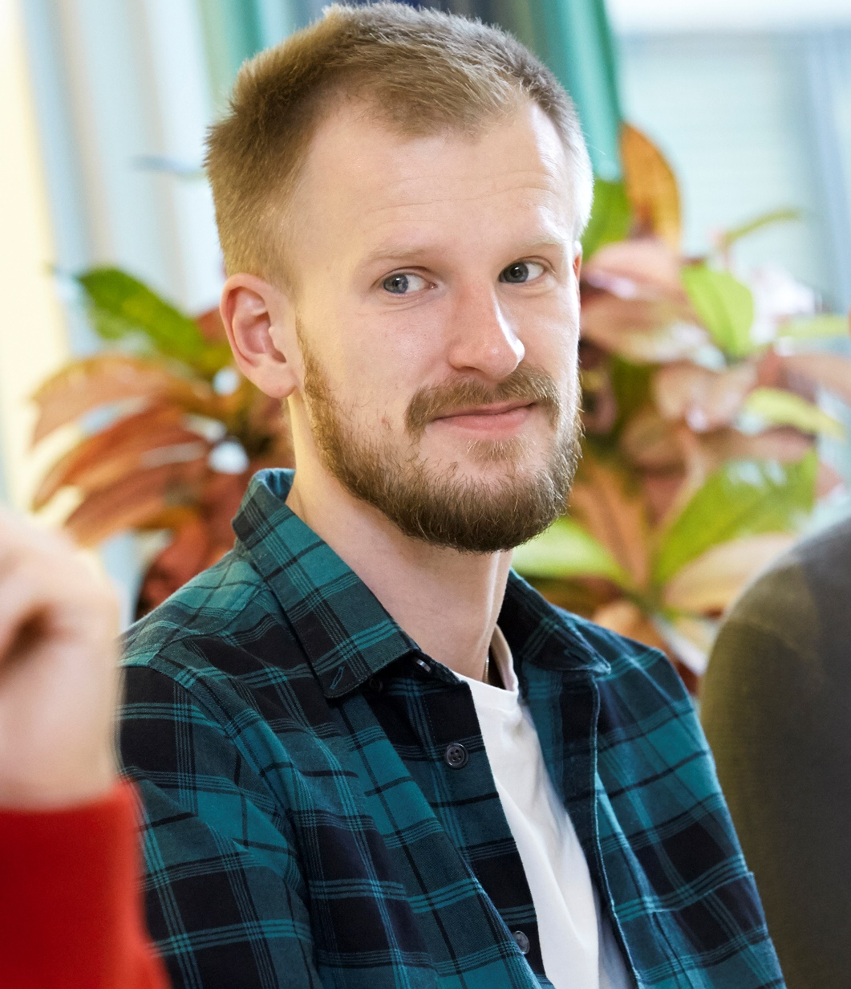
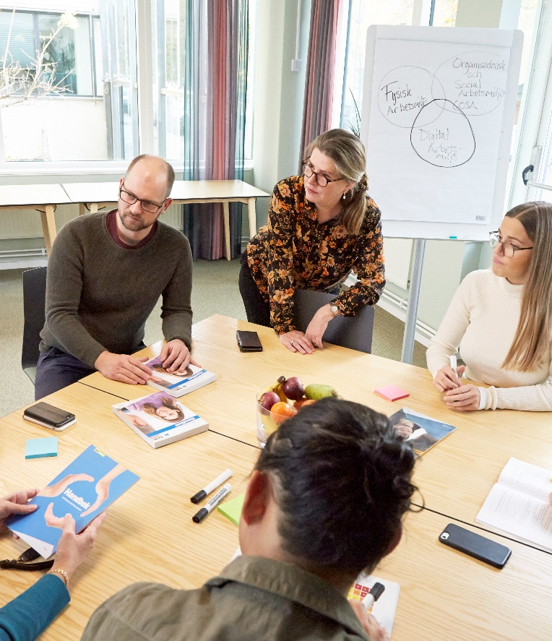
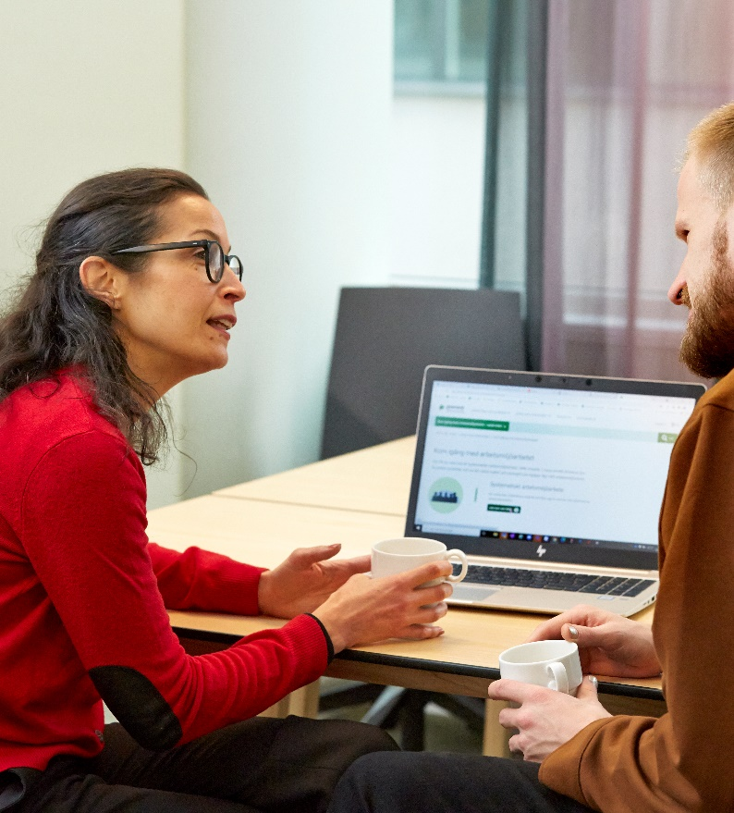
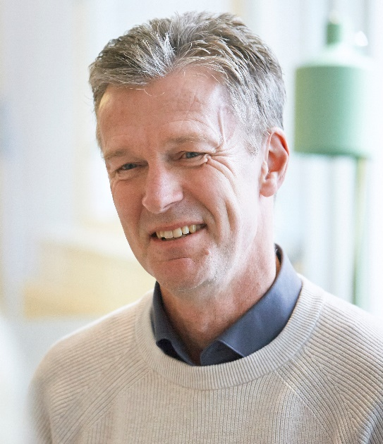
When we talk …
we listen to each other’s opinions
it’s OK to have different opinions
we talk about what’s good and worth keeping, as well as what needs to be improved
we try to see the big picture and not get bogged down in details.
www.prevent.se/enkater
Notes:
Maybe you’ve developed your own code of conduct? If so, use it.

Slide 9
RESULTS
www.prevent.se/enkater
Notes:
Show the results
When you present the results to your employees, you can do so in different ways. You can base it on the link to the results/the results pages and scroll through. One option is to download the results as a PDF and show them the PDF file.
The PDF does not show free text responses or spread, just the median. On the results page, clicking on a result (a yellow circle) shows the spread. The free text responses can be found at the bottom of the overview. Our recommendation is to show the results with the median value and not the spread. This is to avoid getting bogged down in details and prevent anyone from wondering who might have given a diverging answer.

Slide 10

3 minutes individual reflection
What stands out?
What do I relate to?
What don’t I relate to?
www.prevent.se/enkater
Notes:
The aim of this exercise is to give everyone the opportunity to settle on their own reflections before processing them in a group setting. It’s easy to be influenced by other people in the group once you start discussing things together.

Slide 11

Questions for group reflection
What works well today?
Select three survey questions with good results.
Why does it work well?
What needs to be improved?
Select three survey questions with poor results.
Why have you selected these questions? How do they pose a risk?
What factors lie behind the poor results for these questions?
Write down the questions you selected on separate Post-it notes
www.prevent.se/enkater
Notes:
Tell them that the aim of the discussion exercise is to find out what you want to continue working on and the questions/areas you want to prioritise.
To make sure everyone’s perspective is taken into account, you first discuss in small groups, followed by a large group discussion.
Hand out a pad of Post-it notes to each group and a printed copy of the results to each person.
On the Post-it notes, each group should write down the six questions it has selected. They will then present this to the large group.
Tell the groups when you will be reconvening the large group. Around 30–40 minutes of discussion is usually a good amount.
Select three survey questions that demonstrate poor results (corresponds to the first column in the action plan, ‘What needs to be improved’)
Why have you selected these questions? How do they pose a risk? (corresponds to the second column in the action plan, ‘Why is it a risk?’)
What is behind the poor results? (corresponds to the ‘Causes of risk’ column in the action plan)

Slide 12
Division into groups
Group 1:
Group 2:
Group 3:
Group 4:
www.prevent.se/enkater
Notes:
Think about the division into groups. How many people in each group? How many groups in total? The more groups, the more suggestions you’ll come up with and need to prioritise among. The more people in each group, the fewer of them will be heard. Three to five people per group is usually a good number.

Slide 13
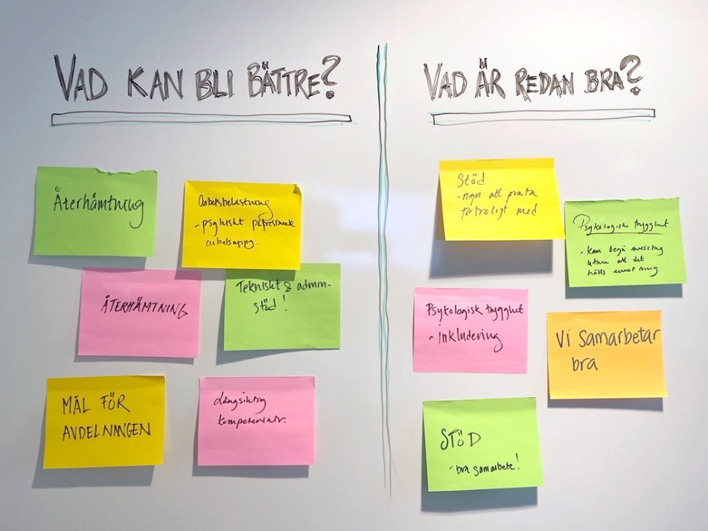
Reconvening the large group
Each group presents its suggestions for questions to continue working on and posts its Post-it notes.
Both what’s good already and worth keeping, as well as what needs to be improved.
www.prevent.se/enkater
Notes:
For example, you can draw two fields on a whiteboard. At the top of one of them, write ‘Things that are good already’ and in the other, ‘Things that need to be improved’.
Each group presents its suggestions and posts its Post-it notes in the two fields. The group members also briefly explain their reasoning and what is behind them.
If there are similar suggestions, start by grouping them.
This can obviously be done in other ways, such as by using a digital solution.

Slide 14
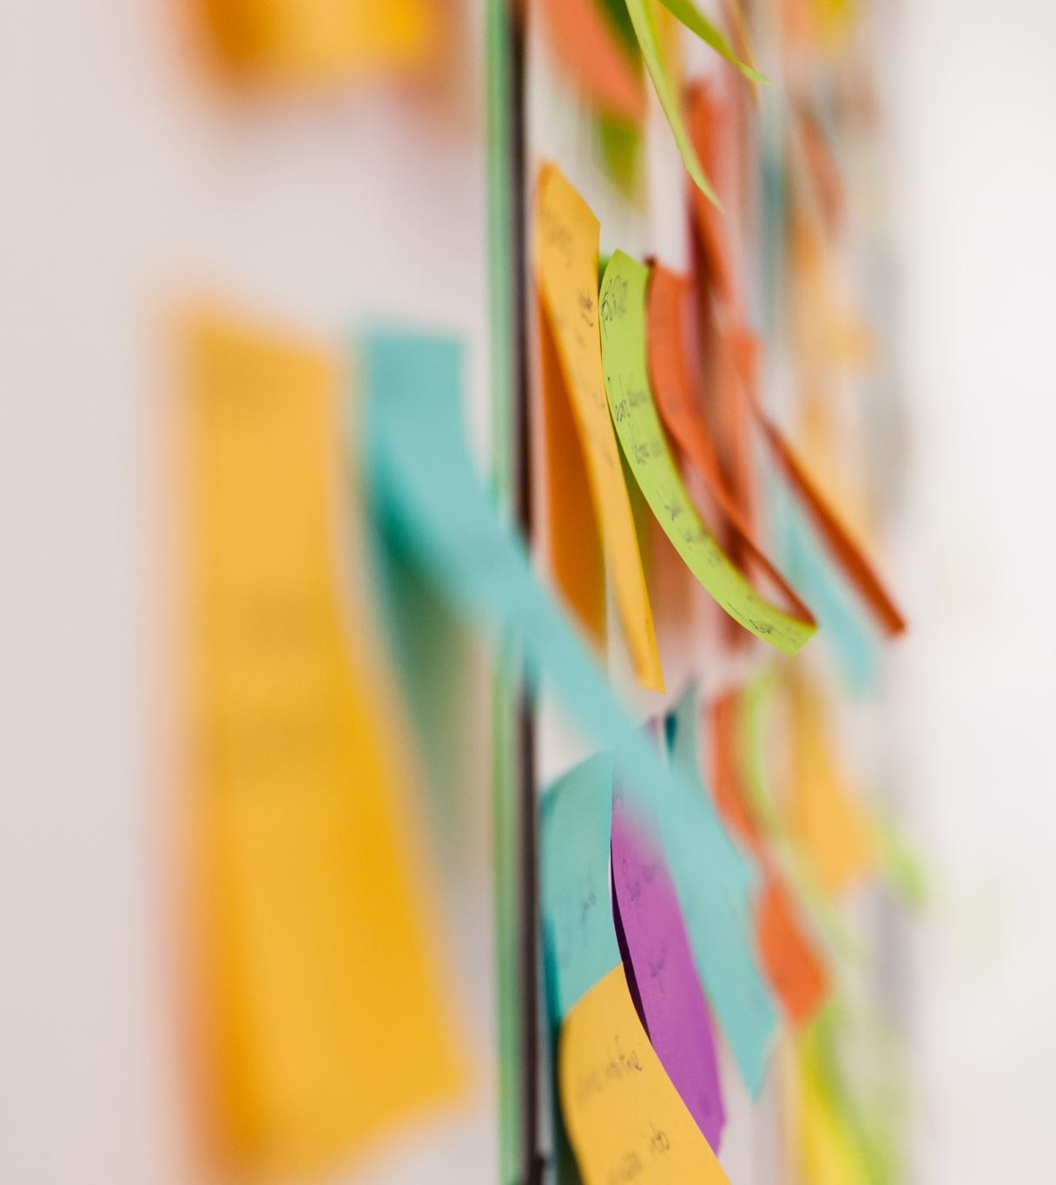
Prioritise questions or areas to continue working on
prevent.se/jobba-med-arbetsmiljo/enkater/osa-enkaten
www.prevent.se/enkater
Notes:
Decide on the number of questions it is reasonable to work on. It’s better to have an action plan with fewer measures that are actually taken than one with many that are not. You can also park certain questions for later.
Together, prioritise among the questions you want to continue working on, for example by marking four questions each. The questions that receive the most votes are those you will move forward with.
Write down in the action plan what you’ve decided to keep working on.
NOTE If, as a manager, you’ve noticed any questions associated with a high risk, you need to make sure they’re included in the action plan.

Slide 15

Action plan
www.prevent.se/enkater
Notes:
Fill in the risks in the first four columns of the action plan, during or after the meeting.
Fill in what you want to move forward with in the first two columns in the lower section.
You now have an initial action plan you can continue working on at the next meeting.
The action plan template can be downloaded here: https://www.prevent.se/jobba-med-arbetsmiljo/enkater/osa-enkaten/resultat-och-atgarder/

Slide 16

What will we do at our next meeting?
Develop measures and finish the action plan.
www.prevent.se/enkater

Slide 17
MEETING 2

Slide 18
The OSWE survey Meeting 2. Action plan
Department/company
Date
www.prevent.se/enkater
Notes:
Before meeting 2:
Prior to the next meeting, the person(s) running the survey should make a risk assessment (low/medium/high) of the questions you’ve decided to work on. Sometimes it’s difficult to assess risks because you don’t understand their causes. Try to get to grips with the causes together by discussing this in the group. If this is insufficient, another option is to get an external expert resource to conduct interviews with the employees.
Make sure that you fill in the first four columns of the action plan for risks and the first two for what’s working well.
Ensure that any high-risk questions are included in the action plan.
Print out the action plan so that there is one copy per discussion group.

Slide 19
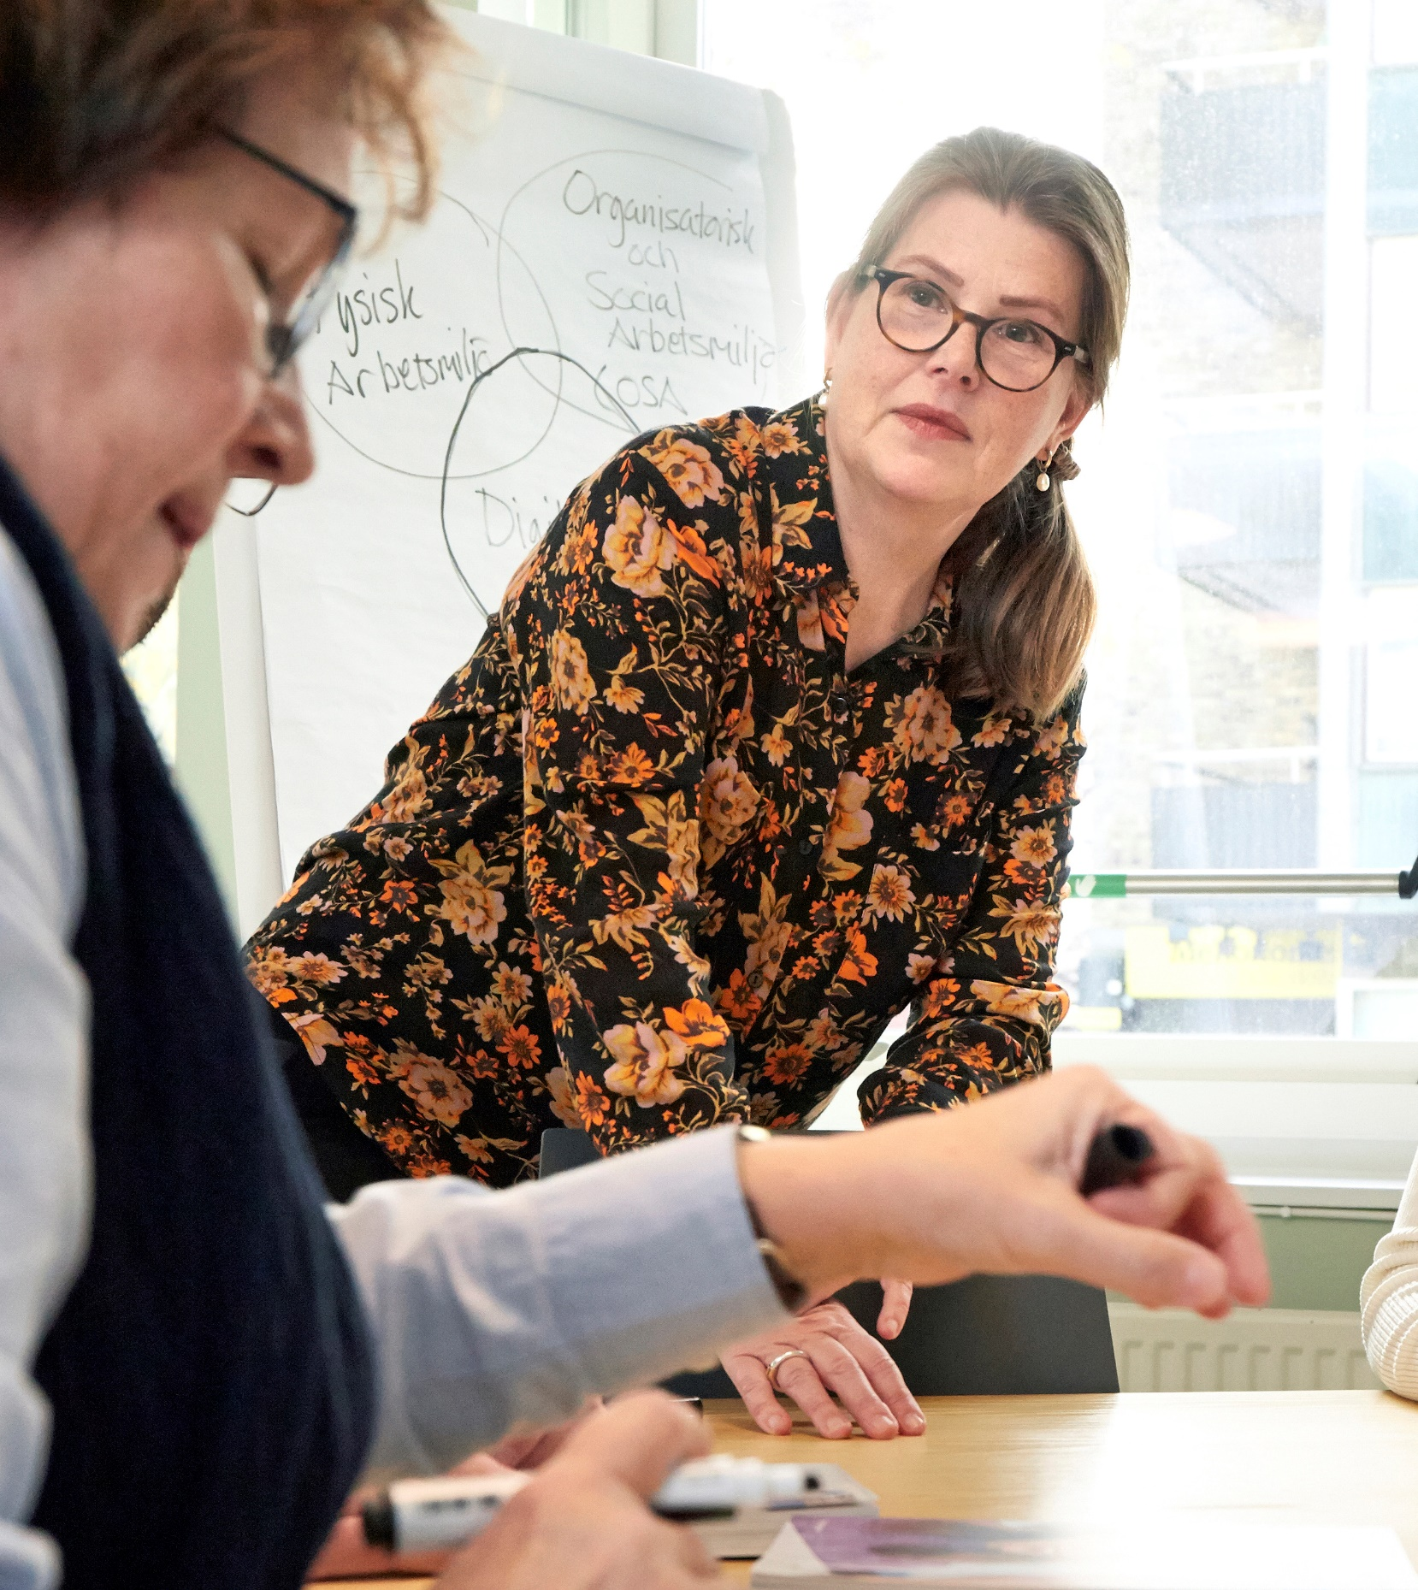
Agenda for today’s meeting
Come up with suggestions for measures, in groups.
Present the suggestions.
Prioritise among the suggestions.
Complete the action plan.
www.prevent.se/enkater

Slide 20
Action plan
www.prevent.se/enkater
Notes:
Include a copy of your own completed action plan, in which you’ve filled in columns 1, 2, 3 and 4 for risks and 1 and 2 for what you want to strengthen, during and after the previous meeting.
Recap on what you agreed as a group in the previous meeting and tell them that today, you’ll continue working on the action plan, filling in columns 5, 6, 7 and 8.
The action plan template can be downloaded here: https://www.prevent.se/jobba-med-arbetsmiljo/enkater/osa-enkaten/resultat-och-atgarder/

Slide 21
Sample action plan
www.prevent.se/enkater
Notes:
A sample risk assessment and action plan to get an idea of what they might look like. Show the employees the slide if you think it can provide them with ideas for how to tackle causes and measures in the next exercise.
The full sample action plan can be downloaded here: https://www.prevent.se/jobba-med-arbetsmiljo/enkater/osa-enkaten/resultat-och-atgarder/

Slide 22
Division into groups
Group 1:
Group 2:
Group 3:
Group 4:
www.prevent.se/enkater
Notes:
There are different ways of working with the measures. Either all groups can come up with suggestions for measures for all the questions you’ve chosen to prioritise. Or you can divide them up, with one or two questions assigned to each group. The advantage of dividing them up is that it takes less time. The advantage of all groups working on all the questions is that it gets them more involved.

Slide 23
Group discussion – measures
Base this on the areas you want to continue working on and come up with suggestions for measures.
What is to be achieved and how should this be done?
www.prevent.se/enkater
Notes:
Give out a pad of Post-it notes to each group. Let them know when you’ll be reconvening the large group. Around 30 minutes of discussion is usually a good amount.
what is to be achieved? (corresponds to column 5 of the action plan)
how should it be done? (corresponds to column 6 of the action plan)

Slide 24
Reconvening the large group
Each group presents its suggestions for measures.
www.prevent.se/enkater
Notes:
Each group presents its suggestions for measures, and colleagues get the opportunity to ask questions and provide input.

Slide 25
Prioritise among the suggestions
prevent.se/jobba-med-arbetsmiljo/enkater/osa-enkaten
www.prevent.se/enkater
Notes:
Depending on how you decided to work in the groups and how many suggestions for measures you received, you may need to prioritise among the measures.
Determine in advance the number of measures/activities it is reasonable to work on. It’s better to have an action plan with fewer measures that are actually taken than one with many that are not.
Let the employees prioritise which measures to continue working on by voting or discussing them together, for example. The measures that receive the most votes are the ones you will move forward with.
The measures must be practically and economically feasible in relation to the risk.
As the person running the survey, you should ensure the measures are in line with your company’s policies and guidelines.

Slide 26
Action plan
www.prevent.se/enkater
Notes:
Either fill in the columns together during the meeting as shown above, or the person(s) running the survey can do it afterwards.
The manager doesn’t need to be responsible for all the measures. Allocating responsibility when it comes to measures helps people take ownership of them.
It’s often the case that you won’t have time to finish the action plan. If you finish it after the meeting, it’s important to review the completed plan with the team on another occasion.
The action plan template can be downloaded here: https://www.prevent.se/jobba-med-arbetsmiljo/enkater/osa-enkaten/resultat-och-atgarder/

Slide 27

Next steps
www.prevent.se/enkater
Notes:
Inform the team of the next steps.
Does the action plan need to be finished?
Once the action plan is ready, it’s time to continue working on the measures.
Don’t forget to follow up on the measures to see if they’ve produced the desired effect.

