Slide 1

Survey on the digital work environment
Survey follow-up
Notes:
Once employees have completed the survey, you review the results and discuss them as a group.
It is important that everyone in the work group is involved and has the opportunity to speak. Alternate discussions in the full group with conversations in smaller groups.
The purpose of the survey is to capture employees’ experiences of the digital work environment, with the results forming a basis for discussions on how workplaces can implement improvements.
It is common to focus on the lowest scores, but it is equally important to discuss what is already working well and should be maintained or further strengthened

Slide 2
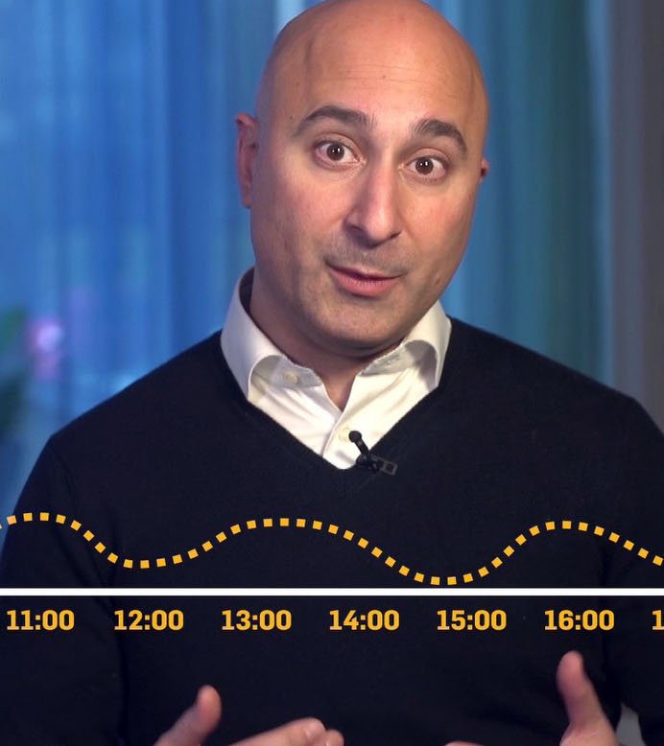
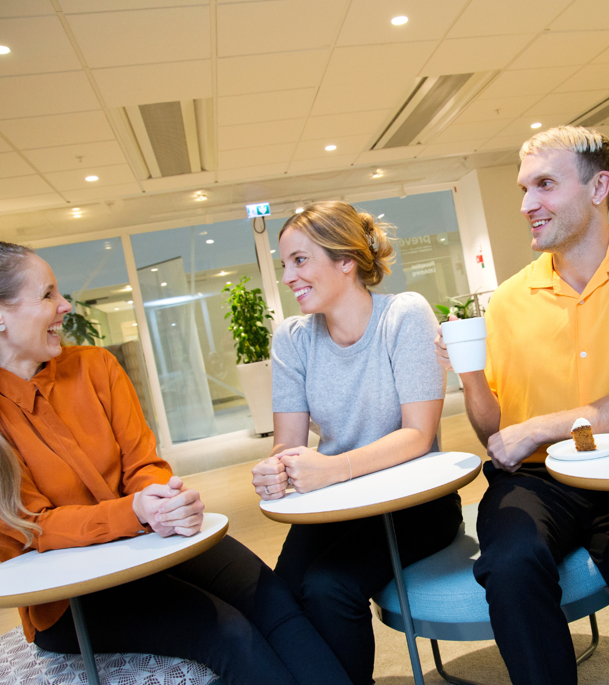
Agenda
1. Go through the results together.
2. In small groups, come up with suggestions for what we should continue working on.
3. Present suggestions.
4. Prioritise what to continue working on and create an action plan.

Slide 3
Results
Notes:
Show the results
When you present the results to your employees, you can do so in different ways. You can base it on the link to the results/the results pages and scroll through. One option is to download the results as a PDF and show them the PDF file.
The PDF does not show free text responses or spread, just the median. On the results page, clicking on a result (a yellow circle) shows the spread. The free text responses can be found at the bottom of the overview. Our recommendation is to show the results with the median value and not the spread. This is to avoid getting bogged down in details and prevent anyone from wondering who might have given a diverging answer.

Slide 4
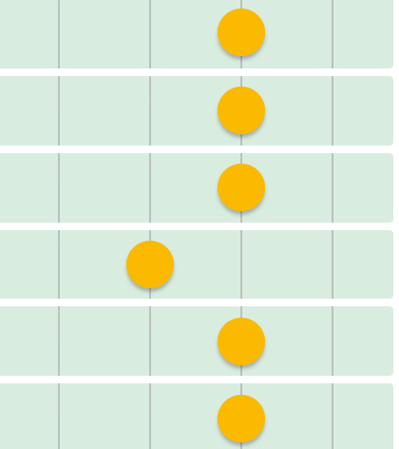
Individual reflection
What stands out?
What do I relate to?
What don´t I relate to?
www.prevent.se/enkater
Notes:
The aim of this exercise is to give everyone the opportunity to settle on their own reflections before processing them in a group setting. It’s easy to be influenced by other people in the group once you start discussing things together.

Slide 5
Division into groups
Group 1:
Group 2:
Group 3:
Notes:
Allocate approximately 20–40 minutes.
Discuss the results in small groups (2–6 participants).

Slide 6
Questions for
group reflection
What works well today and worth keeping?
Why does it work well?
What needs to be improved?
What factors lie behind the poor results for these questions?
Suggested actions
Notes:
Hand out a printed copy of the results to everyone.
Inform the group when you will reconvene.
Time required: approximately 30 minutes.

Slide 7

Reconvening
What works well today and worth keeping?
What needs to be improved?
What factors lie behind the poor results for these questions?
Suggested actions
Notes:
As a suggestion, create two sections on a whiteboard. In one section, write ‘Things that are already working well,’ and in the other, ‘Things that need improvement

Slide 8
What should we continue working on?
Discuss the proposals
Prioritize the proposals
Develop an action plan”

Slide 9
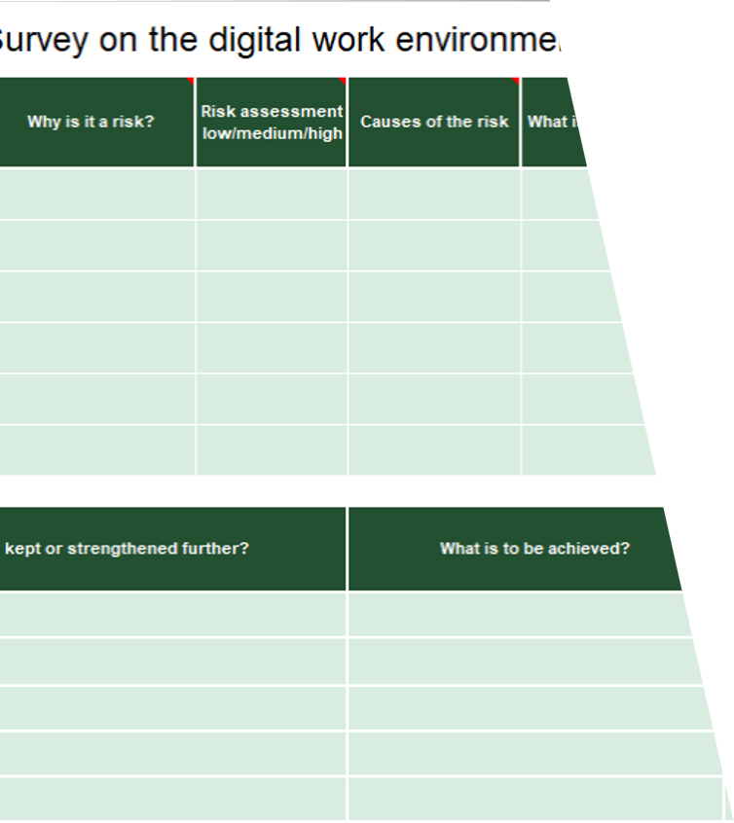
Action plan
What needs to be done
How it should be done
Who is responsible
When it should be completed
prevent.se/jobba-med-arbetsmiljo/enkater/osa-enkaten
Notes:
It is recommended to establish an action plan for the measures that are decided

